Slide 1
Aspergillus/Rare Molds
Revised 5/2024 (in final stages)
Working group chairs: Martin Hoenigl, Monica A. Slavin

Slide 2
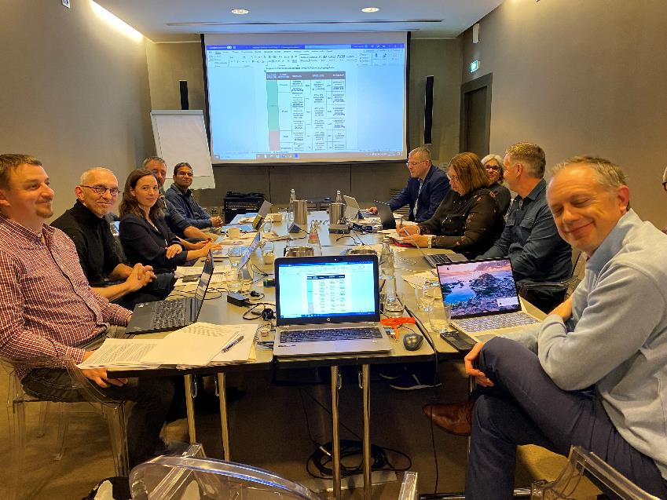
Aspergillus/Moulds Working Group
ECMM | MSGERC
Martin Hoenigl, CoChair | Monica Slavin, CoChair
Oliver Cornely | GR Thompson
Johan Maertens | Tom Patterson
Jean Pierre Gangneux | Jessica Little (EC)
Connie Las-Florl | Dimitrios Kontoyiannis*
Ritesh Agarwal | Luis Ostroski*
Bart Rijnders (EC) | Peter Pappas*
 | Marcio Nucci^
Gerald McGwin* | Gerald McGwin*
Carolynn Jones | Carolynn Jones
Location: Rosa Grande Hotel, Milan, IT * By Zoom; ^ unable to attend

Slide 3
Timeline
In person meeting: Milan, Jan 23 & 24, 2024
Finalization of manuscript draft
Review of manuscript and feedback from FDA
In progress (est date completion June 30th 2024):
Review and feedback from EMA
Review by Paediatrics group (Prof. Tom Wals & Prof. Emmanuel Roilides)
Patient Review and patient focused listening session
Final Steps:
Public Review
Presentation of Results at MSG-ERC biennial meeting, Colorado Spring, September 2024
Publication

Slide 4
Table 1. Summary of Framework for Response Criteria for Aspergillus/Other Mould Infections in Clinical Trials
Success | Complete | Complete or partial resolution of attributable signs/symptoms AND Complete radiologic response AND Complete mycologic response
 | Partial | Complete resolution of attributable signs/symptoms AND Partial or stable radiologic response AND Complete mycologic response Partial resolution of attributable signs/symptoms AND Partial or stable radiologic response AND Complete mycologic response Stable signs/symptoms AND Complete or partial radiologic response AND Complete mycologic response
Failure | Stable | Stable signs/symptoms AND Stable radiologic response AND Any mycologic response
 | Progression | Worsening signs/symptoms OR Worsening radiologic response OR Persistent mycologic findings
 | Death | Death with or due to fungal infection during evaluation period
Salvage | If patients with positive mycologic criteria at diagnosis do not have positive mycologic criteria at time of study enrollment and follow up, then response would be based upon clinical and radiographic criteria alone.

Slide 5
SUCCESS / FAILURE | GLOBAL RESPONSE | CLINICAL |  | RADIOLOGY⁴ |  | MYCOLOGY⁷
Success | Complete^{1,2,3} | Complete resolution of all attributable signs/symptoms (COMPLETE) | AND | >90% radiographic reduction (COMPLETE) | AND | Eradication or presumed eradication (COMPLETE)
 |  | Improvement in ≥1 attributable signs/symptoms on ordinal scale (PARTIAL) | AND | >90% radiographic reduction (COMPLETE) | AND | Eradication or presumed eradication (COMPLETE)
 | Partial | Complete resolution of all attributable signs/symptoms (COMPLETE | AND | 25% to 90% radiographic reduction (PARTIAL) | AND | Eradication or presumed eradication (COMPLETE)
 |  | Complete resolution of all attributable signs/symptoms (COMPLETE | AND | -10% to +25% radiographic reduction (STABLE) | AND | Eradication or presumed eradication (COMPLETE)
 |  | Improvement in ≥1 attributable sign/symptom on ordinal scale (PARTIAL) (*) | AND | 25% to 90% radiographic reduction (PARTIAL) (*) | AND | Eradication or presumed eradication (COMPLETE) (*)
 |  | Improvement in ≥1 attributable sign/symptom on ordinal scale (PARTIAL) | AND | -10% to +25% radiographic reduction (STABLE) | AND | Eradication or presumed eradication (COMPLETE)
 |  | No change in attributable signs/symptoms (STABLE) | AND | >90% radiographic reduction (COMPLETE) | AND | Eradication or presumed eradication (COMPLETE)
 |  | No change in attributable signs/symptoms (STABLE) | AND | 25% to 90% radiographic reduction (PARTIAL) | AND | Eradication or presumed eradication (COMPLETE)
Table 2. Matrix for Adjudication of Response Criteria for Aspergillosis and other Mold Infections in Clinical Trials
• Treatment response to be assessed at 42 and 84 Days
• Baseline mycologic criteria to which the treatment response will be compared should be from patient samples taken +/- 7 days of treatment initiation
• Baseline radiographic imaging for pulmonary and cerebral aspergillosis generally recommended within 7days before treatment initiation
• Baseline radiographic imaging for non-pulmonary and non-cerebral aspergillosis generally recommended within 3 weeks before treatment initiation
Footnotes:
If no signs/symptoms at baseline and completion; then patients can still be assessed to have complete response if there is survival within the study period.
If follow up radiology is not available, then this is does not translate automatically into failure – depends on mycologic / clinical criteria.
In patients in the intensive care unit and patients with structural lung disease, persistent respiratory culture positivity might be seen and could represent colonization, thus should not exclude a complete or partial response.

Slide 6
Footnotes:
1. If no signs/symptoms at baseline and completion; then patients can still be assessed to have complete response if there is survival within the study period.
2. If follow up radiology is not available, then this is does not translate automatically into failure – depends on mycologic / clinical criteria.
3. In patients in the intensive care unit and patients with structural lung disease, persistent respiratory culture positivity might be seen and could represent colonization, thus should not exclude a complete or partial response.
4. If there is mixed radiographic response, recommend ruling out other infections and if radiological worsening compared to baseline is due to non-fungal pathogen, this could still classify as partial response.
5. In certain invasive mold diseases, stabilization of fungal disease during periods of severe immunocompromise provides evidence of efficacy of treatment and may be a reasonable short-term therapeutic goal until immune recovery occurs.
6. If death unlikely related to fungal disease, clinical mycologic, radiologic, and global response should be assessed.
7. Antifungal susceptibility testing should be performed in repetitively culture positive samples to monitor development of resistance.
8. Only in the absence of worsening radiology and worsening clinical response.
Worsening imaging needs to be interpreted considering potential immune reconstitution,
SUCCESS / FAILURE | GLOBAL RESPONSE | CLINICAL |  | RADIOLOGY⁴ |  | MYCOLOGY⁷
Failure | Stable⁵ | No change in attributable signs/symptoms (STABLE) | AND | -10% to +25% radiographic reduction (STABLE) | AND | Any mycological response (Persistence OR Eradication)
 | Stable⁸ | Improvement/Resolution of attributable signs/symptoms (PARTIAL/COMPLETE) | OR | >25% radiographic reduction (PARTIAL/COMPLETE) | AND | Persistence (FAILURE)
 | Progression | Worsening of any attributable sign/symptom on ordinal scale | OR | New sites of disease or ≥10% radiographic increase⁹ | AND | Any mycological response (Persistence OR Eradication)
 | Death⁶ | Death during prespecified period of evaluation

Slide 7
Table 3. Classification of Death in Pts with IFD
Death Classification | Criteria for Classification
Death due to IFD | Death was directly due to consequences of progressive invasive fungal disease or antifungal treatment
Death associated with IFD | Death was associated with residual or ongoing fungal disease or treatment. The fungal disease was likely a contributing cause of death along with other condition(s) such as progression of underlying disease
Death not associated with IFD | Death was not associated with residual or ongoing invasive fungal disease or antifungal treatment and likely due to progression of underlying disease or other condition(s) not related to the fungal infection
Indeterminant | Not associated with 3 above categories

Slide 8
Supplementary Table. Symptoms for Assessment of Pulmonary Aspergillosis (CTAE)
Attributable Symptom | Grade 0 | Grade 1 | Grade 2 | Grade 3 | Grade 4
Dyspnea | Not present | Mild | Moderate, medical intervention indicated | Severe, limiting ADLs | -
Cough | Not present | Mild | Moderate, medical intervention indicated | Severe, limiting ADLs | -
Pleuritic chest pain | Not present | Mild | Moderate, medical intervention indicated | Severe, limiting ADLs | -
Bronchopulmonary hemorrhage (hemoptysis) | Not present | Mild | Moderate | Severe, hospitalization or invasive intervention indicated | Life-threatening
Hypoxia / Respiratory Failure | Not present | - | Need for intermittent supplemental oxygen | SpO2 <88% or PaO2 <55; Need for continuous supplemental oxygen | Life-threatening intubation / ventilatory support indicated
Attributable Fever | Not present | 38.0 - 39.0 degrees C (100.4 - 102.2 degrees F) | >39.0 - 40.0 degrees C (102.3 - 104.0 degrees F) | >40.0 degrees C (>104.0 degrees F) for <=24 hrs | >40.0 degrees C (>104.0 degrees F) for >24 hrs
Attributable Sepsis | Not present | Fever with or without constitutional symptoms | Hypotension responding to fluids | Hypotension managed with one pressor | Life-threatening; multi-pressor shock

Slide 9
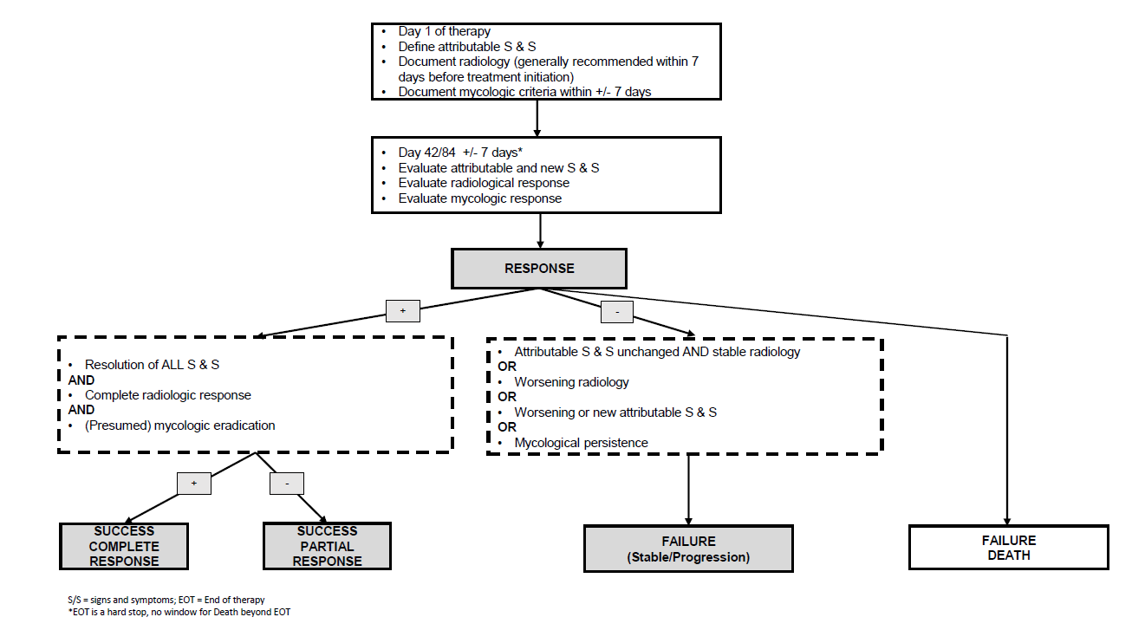
Figure 1- Response evaluation flowchart for primary antifungal therapy- Aspergillus/Moulds

